Slide 1
Module 4
Testing Automation

Slide 2
Automation Testing or Test Automation is a software testing technique that performs using special automated testing software tools to execute a test case suite
On the contrary, Manual Testing is performed by a human sitting in front of a computer carefully executing the test steps
The automation testing software can also enter test data into the System Under Test, compare expected and actual results and generate detailed test reports
Test Automation demands considerable investments of money and resources

Slide 3
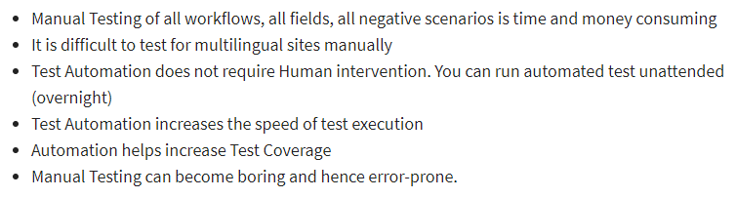
Why Test Automation?
Test Automation is the best way to increase the effectiveness, test coverage, and execution speed in software testing
Automated software testing is important due to the following reasons:

Slide 4
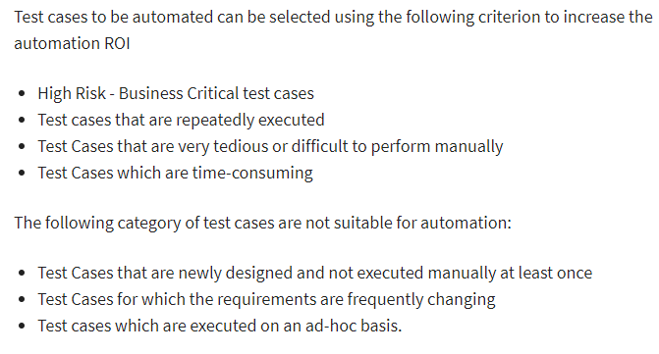
Which Test Cases to Automate?

Slide 5
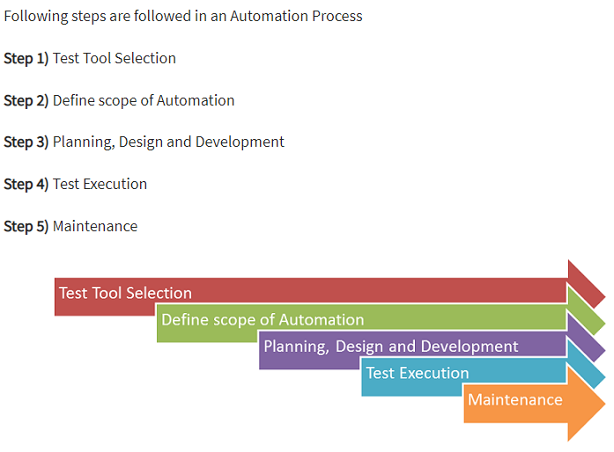
Automated Testing Process:

Slide 6
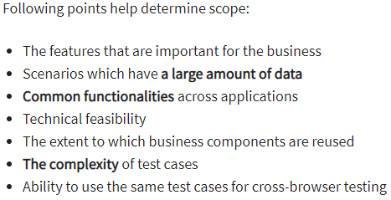
Test tool selection
Test Tool selection largely depends on the technology the Application Under Test is built on
Define the scope of Automation

Slide 7
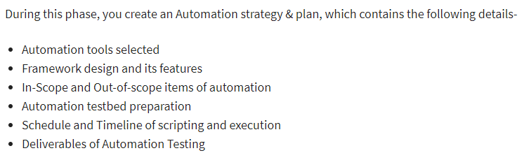
Planning, Design, and Development
Test Execution
Automation Scripts are executed during this phase
The scripts need input test data before there are set to run
Once executed they provide detailed test reports

Slide 8
Test Automation Maintenance Approach
Test Automation Maintenance Approach is an automation testing phase carried out to test whether the new functionalities added to the software are working fine or not
Maintenance in automation testing is executed when new automation scripts are added and need to be reviewed and maintained in order to improve the effectiveness of automation scripts with each successive release cycle

Slide 9
Automation Testing Tools
Classify the tools based on the specific methodology used
Capture and Playback
Test cases are executed manually only once, the inputs and outputs are recorded
Test can be automatically replayed on a subsequent occasion
Tests csn rerun cheaply and easily large number of times
When test changes captured test becomes invalid and will increase the cost
Invalid test cses to be removed and need toad new test cases
Eg .Selenium , Apache Jmeter etc

Slide 10
Automation Testing Tools
Test Script
Scripts provide input to the unit under test and record output
Testers can employ a variety of languages to express the test scripts
Advantage is once the test is debugged and verified it can be rerun for large number o ftimes. However , debugging the test script to ensure its accuracy requires significant effort.
Changes to the unit under test requires identification , modification and rerun impacted test script
Eg. Testsigma

Slide 11
Automation Testing Tools
Random input test
Test values randomly generated cover input space of the unit under test
Outputs are ignored
The goal is to crash the unit not to check the correctness of the output
It finds only the defects that crash the unit under test but majority of th defects do not the crash the system but simply produce incorrect result.
Eg. MonkeyRunner Tool
Model-based test
A model is a simplified representation of program
These models can be structural or behavioral models like state models and activity models (Markov model, Decision Table, ER model etc..)
A state model based testing generates tests that adequately covers the state space described by the model.
Eg. GraphWalker,

